Slide 1
The children act
Book presentation

Slide 2
Roadmap
Book & author
Step
Step
Step
Step
Introducing the subject
Plot
Conclusions

Slide 3

The
Children act

Slide 4
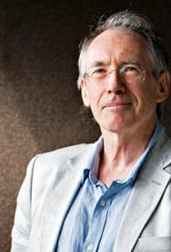
Ian McEwan

Slide 5

The Film

Slide 6
Conclusions

Slide 7
The children act
Book presentation

